Slide 1
Google Bothell Data Analytics/Insights Workshop
June 11, 2020

Slide 2
Goals
Concepts and models needed to do the job
Real code -> tools to get the job done
Increased effectiveness
Higher Value
Session 1: Extracting Insights from Data
Session 2: Statistics for Data Analysis
Session 3: Applied Statistics - Practice
Session 3: Visualizations and Reports

Slide 3
Rules of Engagement
Please ask questions in the chat or speak
We will try and keep on time
Please try and access the Colab Notebooks and follow along
A successful workshop means a two-way conversation

Slide 4
Agenda
Session 1: Extracting Insights from Data
What is an actionable Insight
The Data Science Method
Approach to Planning
Approach to analysis
Results and validation
Extraction methods - Colab, Big Query
Session 3: Applied Statistics
Guided practice using common statistics
Q&A
Op requested statistics topics
Statistics usage tips and tricks - Google SQL
Session 2: Statistics for data analysis
Statistical significance
Regression analysis
T-tests and hypothesis testing
Anomaly detection
Eamples
Session 4: Visualizations
Proper visualizations for different types of data
Common visualizations used in reports
Formatting and content of high impact reports
Examples

Slide 5
Session 1:
What is an actionable Insight
Extraction methods - Colab, Big Query
Planning analysis for a goal
Approach to analysis
Results and validation

Slide 6
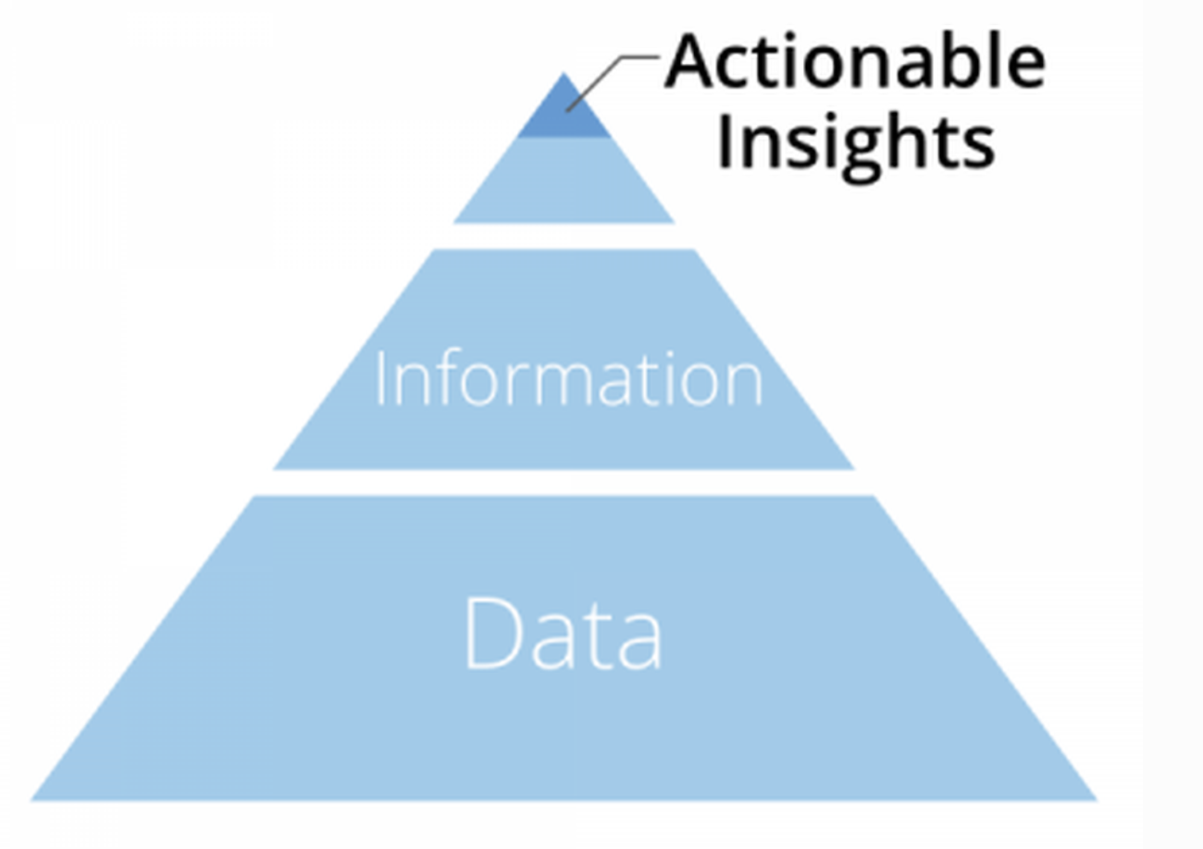
Actionable Insights
Actionable insights sit at the apex of your data pyramid. An insight that drives action is typically more valuable than one that simply answers a question--especially an insight that makes you rethink something and pushes you in a new direction
Insights are generated by analyzing information and drawing conclusions. Both data and information set the stage for the discovery of insights that can then influence decisions and drive change.
Information is prepared data that has been processed, aggregated and organized into a more human-friendly format that provides more context.
Data is the raw and unprocessed facts that are usually in the form of numbers, text, images, video
https://www.forbes.com/sites/brentdykes/2016/04/26/actionable-insights-the-missing-link-between-data-and-business-value/#39f705df51e5

Slide 7
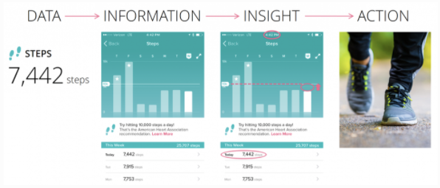
Example from Data to an Actionable Insight
… IDEA …. I can achieve 10K steps per day by adding ~ 2,500 steps with an evening walk
Data: Fitbit steps, miles, calories, BPM, miles, calories, etc.
Information: processed and formatted in to tables and Visuals, weekly steps report
Action: with a little effort in the evening, I can reach my daily target: 2,558 steps needed

Slide 8
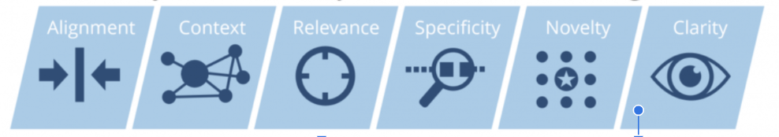
Key attributes of an actionable insight - 1, 2, 3 of 6
Alignment - strategic initiatives, it’s more likely to drive action.
Context - It is hard to move forward on an insight if you are lacking ample background to appreciate why it’s important or unique.
Relevance - In order to be relevant, an insight needs to be delivered to the right person at the right time in the right setting. If insights aren’t routed to the right decision makers, never seen, or too late they will not receive the attention they deserve.

Slide 9
Key attributes of an actionable insight - 4, 5, 6 of 6
Specificity - The more specific and complete the insight is, the more likely it can be acted on. Sometimes insights based on KPIs and other high-level metrics can highlight interesting anomalies but lack sufficient detail to drive immediate action
Novelty - novel insights will have an advantage over more familiar insights. The first time your company spots a particular pattern will be more interesting and compelling than the tenth time. Curiosity can drive people to test or verify an unusual or unexpected finding in the hope that it sheds new light on a key subject area.
Clarity - It is hard to move forward on an insight if you are lacking ample background to appreciate why it’s important or unique.

Slide 10
Insights Examples
Thought exercise … insight key attributes and exercise
Key Attributes/ Insights | Insight 1 | Insight 2 | Insight 3
Alignment | Yes/No?
Context | Yes/No?
Relevance | Yes/No?
Specificity | Yes/No?
Novelty | Yes/No?
Clarity | Yes/No?
Actionable? | Yes/No? | Yes/No? | Yes/No?

Slide 11
Approach to Planning
Follow the Data Science Method
Start with understanding Goals and Objectives
Well designed experiments - meet the assumptions for inference
Randomness
Samples are Independent
Normality
Conclusions backed by statistical relevance and well planned data

Slide 12
The Data Science Method
Model Building
Fit (train) models
Test and Training set
Model test and validation
Review outcomes
Pick final model
Problem Definition
Problem statement
Context
Criteria success
Constraints
Stakeholders
Data sources
Exploratory Data Analysis
Data profile tables and plots
Explore data relationships
Identify features
Identify potential models
Deployment
Dashboards and Reports
Model productionize & deploy
Feature extraction and Preparation
Transformations: dummy variables, one-hot encoding, text mining, vectorization, …
Data Normalization
Analytics pipelines
Data labeling
Data Capture/Wrangling
Data ingestion
Data extraction
Data organization
Data cleaning
Data pipeline
Data quality
Insights and Visualization
Dashboards and Reports
Storytelling
Integrate Into Operations
AI Integration and Automation into Business Operations

Slide 13
DSM: Problem Statement Examples
CA Housing
Business problem: Should we invest in the area?
Technical problem: Predict housing prices for a district?
NY City Taxi Cab (https://towardsdatascience.com/new-york-taxi-data-set-analysis-7f3a9ad84850)
Business Problem: (hypothetical) Ryde share company wants to know how to competitive price its product
Technical Problem predict a taxi fares
Google Bothell - What is the business problem you are trying to solve?
Business Problem?
Technical Problem?

Slide 14
Validation of Results
➔ Decision Statistics
➔ Inference Statistics
How can you be confident that your result is correct?
How do you ask statistical questions and state your conclusions with technical accuracy?

Slide 15
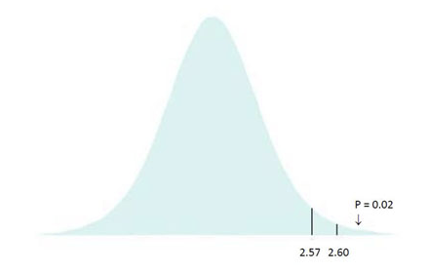
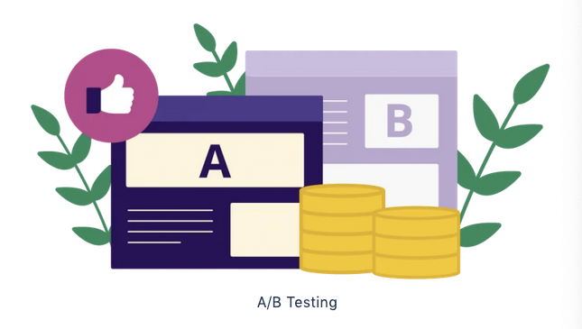
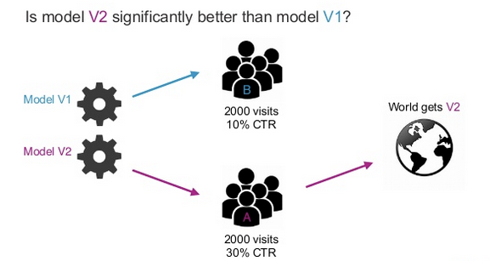
How to validate results: Hypothesis Testing
Inference Statistics - Inferential statistical analysis infers properties of a population, for example by testing hypotheses and deriving estimates. The observed data set is sampled from a larger population.
Confidence
What is the 95% confidence interval around the sampled mea
Hypothesis testing
Is my data conclusive … is my new sample average ŷ really better than ẑ
Marketing
Does web page 1 get more clicks than web page 2
https://vwo.com/ab-testing/
A/B Testing
Is model v2 better than v1
https://www.slideshare.net/turi-inc/machine-learning-in-production

Slide 16
Lab Exercise/Demo: Using BigQuery and Colab
Notebook exercises
Getting Started
Data Extraction
Some Examples
Big Query
Colab
Getting Started
Data Extraction
Some Examples

Slide 17
Session 2: Statistics for data analysis
Statistical significance
Regression analysis
T-tests and hypothesis testing
Anomaly detection
Eamples
Session 3: Applied Statistics
Guided practice using common statistics
Q&A
Op requested statistics topics
Statistics usage tips and tricks - Google SQL

Slide 18
Approach to Data Analysis?
The Data Science Method (DSM)
1. Problem Definition
3. Exploratory Data Analysis
5. Modeling & Analytics
7. Insights Visualization
2. Data Capture & Wrangling
4. Feature Extraction
8. Integrate into Operations
6. Deployment
The plan begins by identifying the problem, goals, etc
Process may not include all steps, depends on the problem
Duration can take from days to several months or a year
https://medium.com/@aiden.dataminer/the-data-science-method-dsm-a-framework-on-how-to-take-your-data-science-projects-to-the-next-91f9fd81e5d1

Slide 19
Types of Statistics in Data Science
Core Statistics Concepts
Descriptive Statistics
Distributions
Inference Statistics - Confidence & Hypothesis testing,
Regression
2. Probability
Basic probability
Priors and Posteriors
Conditional Probability and Total Probability
Maximum Likelihood
Bayesian Probabilities
3. Statistical Models for ML and AI
Regression models
Classification
Supervised, Unsupervised, Semi-supervised
Computer vision and Natural language models
Reinforcement Learning Models
Reference … adapted from https://elitedatascience.com/learn-statistics-for-data-science

Slide 20
What does statistical significance mean?
Statistical significance is a determination by an analyst that the results in the data are not explainable by chance alone. Statistical hypothesis testing is the method by which the analyst makes this determination. This test provides a p-value, which is the probability of observing results as extreme as those in the data, assuming the results are truly due to chance alone. A p-value of 5% or lower is often considered to be statistically significant.
Statistical significance also provides a confidence interval about a statistical measurement, such as 90 % or 95%.
https://www.investopedia.com/terms/s/statistically_significant.asp

Slide 21

Decision Statistics Summary
Decision Type
Distribution Type
Mean or Proportion
Inference (decision) Type |  | Normal Distribution |  | t-Distribution
 |  | Difference in the Mean | Difference in Proportion | Difference in the Mean | Difference in Proportion
Confidence Interval to some specified percentage around the mean or proportion |  | -----+---------- -----------+------ <...95%, 90% …>
Hypothesis Testing |  | H₀ : (Null Hypothesis), expected result, H_{A} : Alternative Hypothesis, the assertion or claim E.g. The null hypothesis maintains the advertised weight of 700 Troy ounces. H₀ the weight is ≥ K . Alternative H_{A} < K (650 Troy ounces)
One-sample statistics e.g., the weight of a sample of gold bars sampled from pallet |  | Default or null hypothesis always states that the sample mean is equal to the expected or advertised mean. The assertion or alternative hypothesis always states that the sample mean is different than the expected mean.
Two-sample statistics e.g. 2 “sub” populations w and w/o cancer |  | A/B test. Is the click rate on web page A different than click rate on web page B?

Slide 22
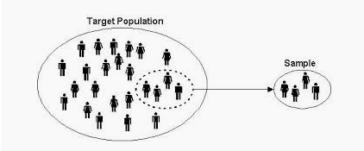
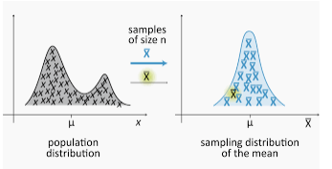
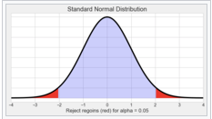
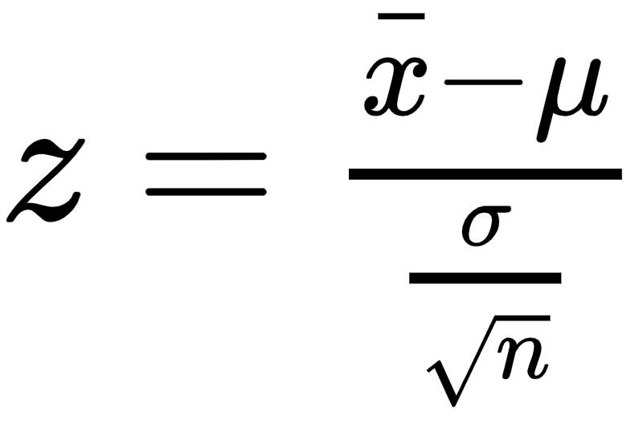
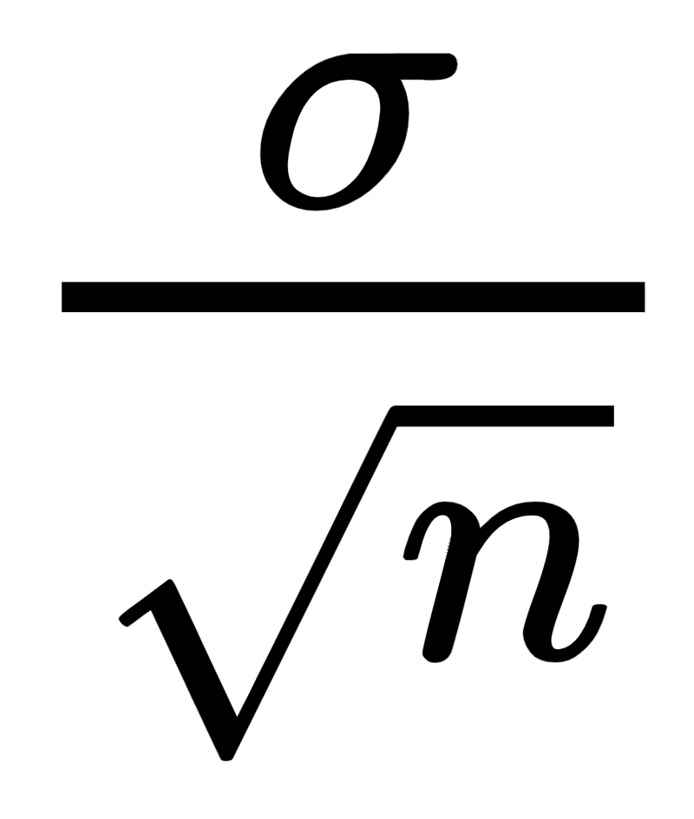
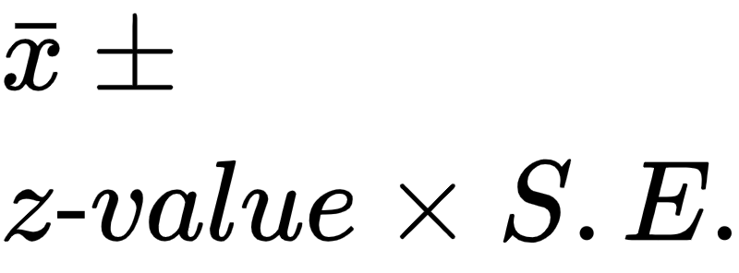
Central Limit Theorem
This theorem is the primary reason why the normal distribution appears in so many statistical results. The theorem can be stated as follows.
For any population distribution with mean μ and standard deviation σ, the sampling distribution is approximately normal with mean μ and standard deviation σ/sqrt(n), and the approximation improves as n increases.
Z ~ Ɲ(μ,σ/√n)
z “statistic” or “z-value” is sample mean converted to the z-axis
Normal Distribution
Many textbooks suggest n ≥ 30 as a rule of thumb. However, this depends heavily on the population distribution.
If the population distribution is very non-normal—extremely skewed or bimodal, for example—the normal approximation might not be accurate unless n is considerably greater than 30. if the population distribution is already approximately symmetric, the normal approximation is quite good for n considerably less than 30.
In the special case where the population distribution is normal then the sampling distribution is normal.
Sample Standard Deviation
S.E =
The sample standard deviation is also called the “standard error” and abbreviated S.E.
Confidence Interval
http://sphweb.bumc.bu.edu/otlt/MPH-Modules/BS/BS704_Probability/BS704_Probability12.html

Slide 23

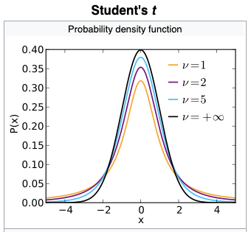
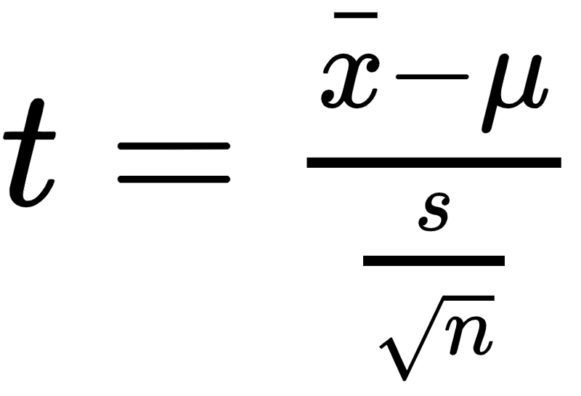
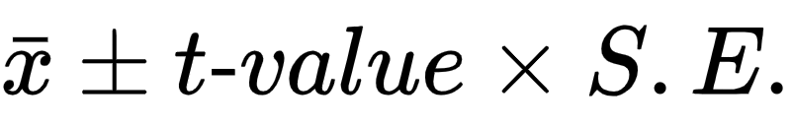
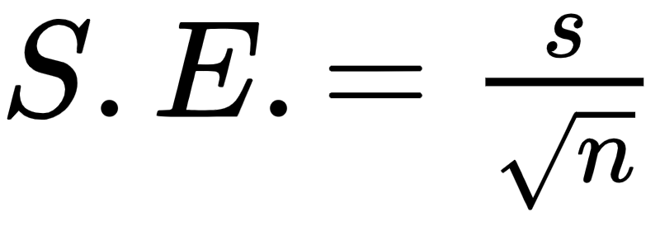
t-distribution: What happens if don’t meet the assumptions for a Normal Distribution?
When to use the t-distribution
When the population standard deviation, σ, is not known (usually the case)
and or when n < 30
What is a t-distribution?
The t-distribution has larger tail than Normal distribution resulting in less confidence as compared to Normal distribution,
For large n it converges with the Normal distribution.
It has a degrees of freedom “df“ (or “ν”) = n -1 samples
William Sealy Gosset published it in 1908 under the pen name “Student” for testing population means for low n and unknown standard deviation
How is it used?
Confidence Interval
Hypothesis Tests
General Example
Start with n samples from a population
Find the sample mean and sample standard deviation
Use the t-value equation get t
Lookup the p-value (area under the tail) corresponding to the confidence level α and degrees of freedom df, p = f(t,df)
-t-value (“t-statistic)
t-value (“t-statistic)
t-statistic for population means
Confidence interval
s = sample mean

Slide 24
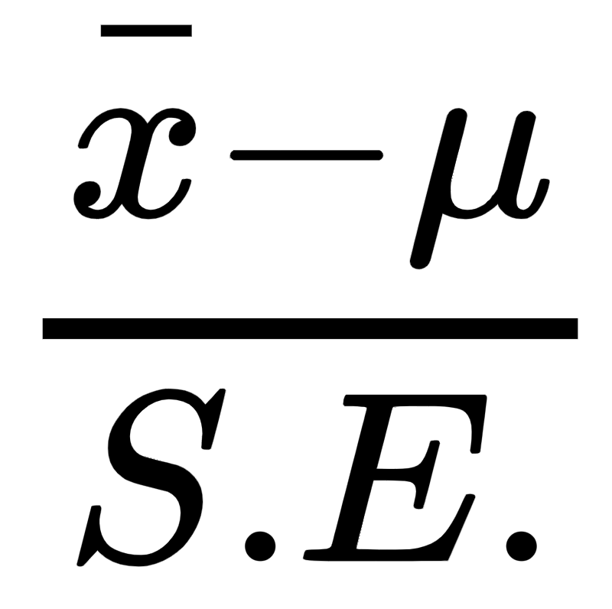
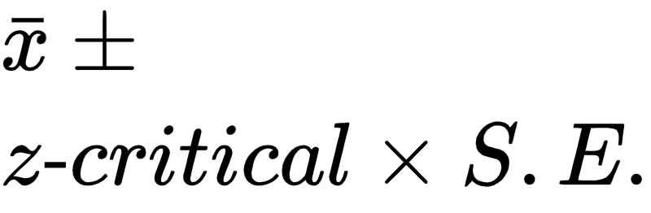
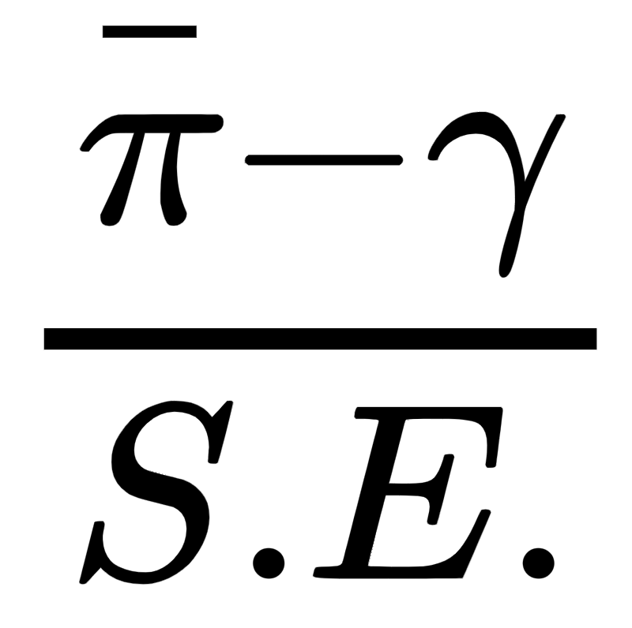
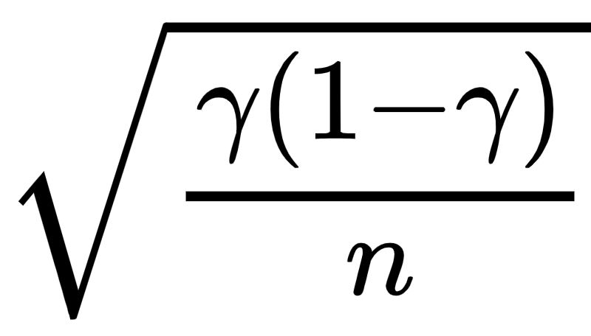
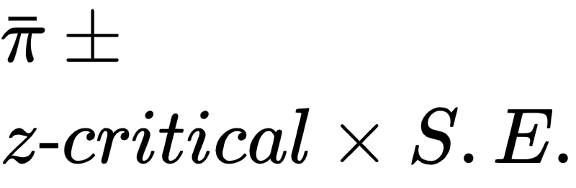
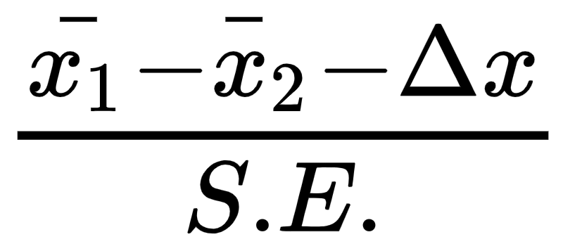
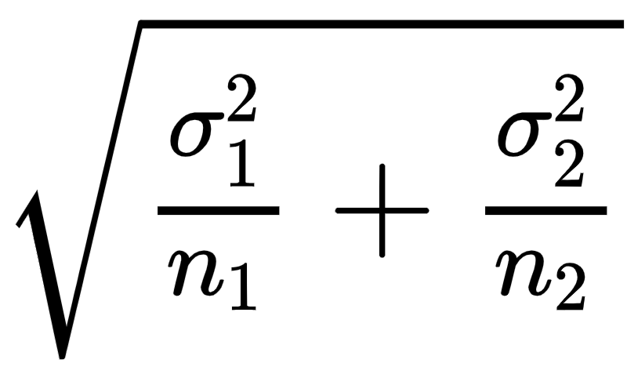
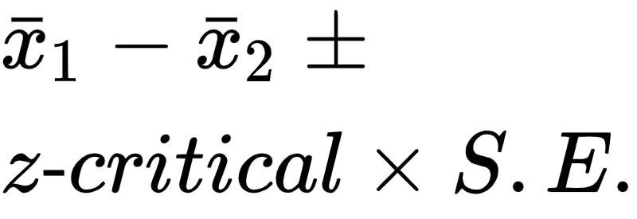
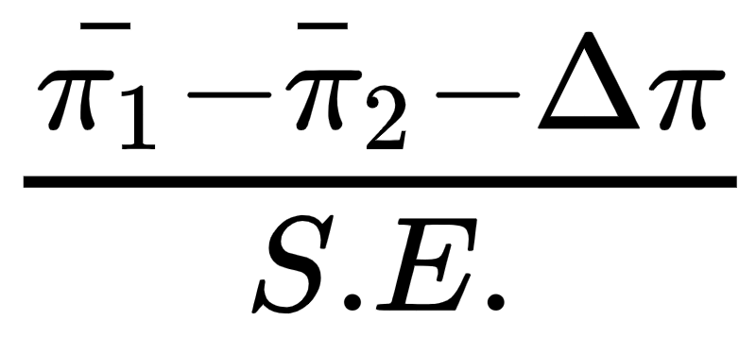
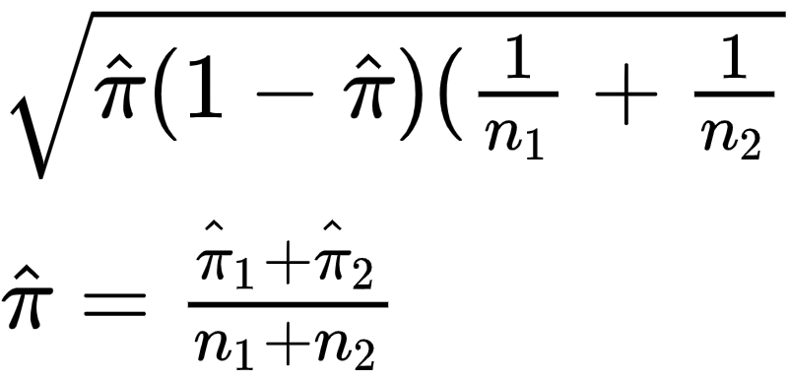
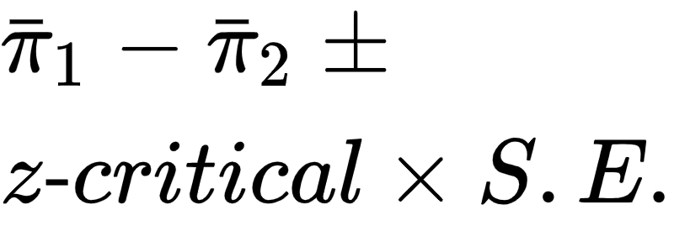
z-statistics, One Sample and Two-Samples
z-test statistics normally distributed, standard deviation(s), σ, are known or lots of samples for a good estimate, n_{i} >> 30, otherwise use t-test
Statistic | z-statistic (z-value) | S.E. | Confidence Interval | Hypothesis Question | Hypothesis One or Two - sided
Sample Mean (quantitative data) |  |  |  | Sample mean is = μ or different (> or <) than the expected mean, μ= X | H₀: μ = X or, μ ≤ X or μ ≥ X X is the advertised mean
Sample Proportions (qualitative data) |  |  |  | Sample proportion (e.g., coin heads proportion) = or different (> or <) than the expected hypothesized proportion, γ=Y | H₀: γ = Y or, γ ≤ Y or γ ≥ Y Y is the advertised proportion
Two- Sample Means (qualitative data) |  |  |  | The difference of two samples means (e.g., avg blood cell counts for two different populations, w and w/o cancer) μ₁ - μ₂ differ by a hypothesized amount (μ₁ - μ₂ = Δx) or are less than or equal to a hypothesized amount Δx. | H₀: μ₁ - μ₂ = Δx or, μ₁ - μ₂ ≤ Δx or μ₁ - μ₂ ≥ Δx
Two- Sample Proportions (quantitative data) |  |  |  | The difference of two sample proportions (e.g., click rate proportion for web page A and B, two different populations) π₁ - π₂ differ by a hypothesized amount (π₁ - π₂ = Δπ) or are less than or equal to a hypothesized amount Δπ. | H₀: π₁ - π₂ = Δπ or, π₁ - π₂ ≤ Δπ or π₁ - π₂ ≥ Δπ π1 and 2 are sample proportions

Slide 25
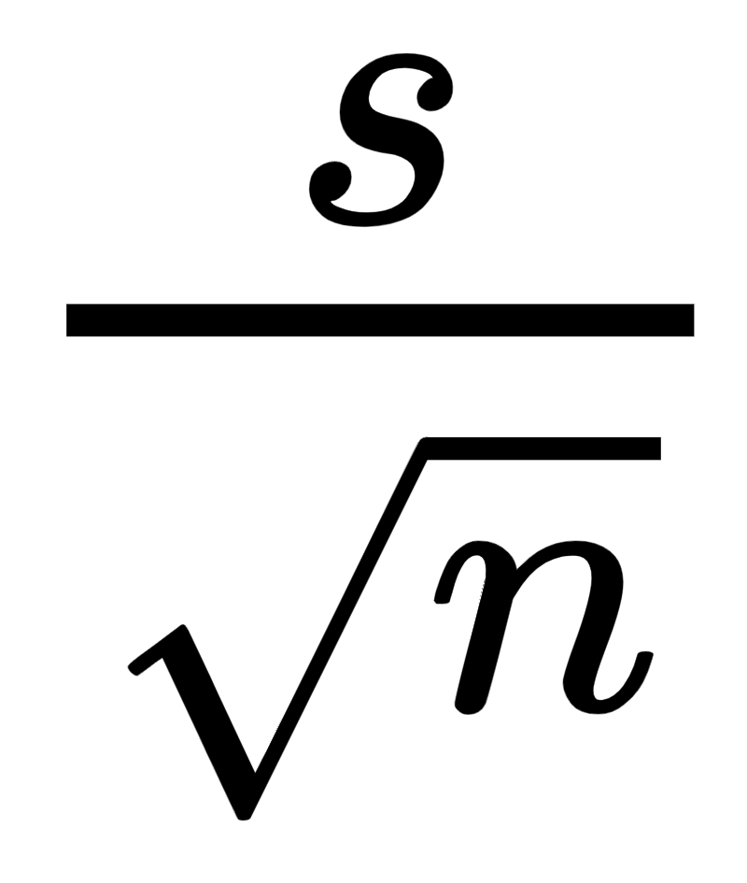
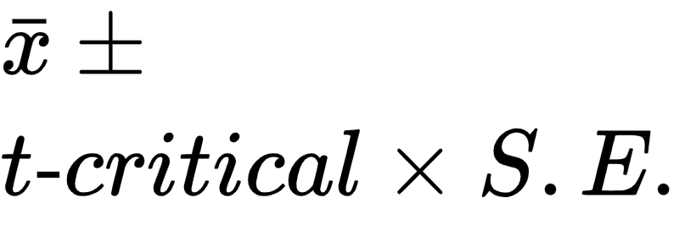
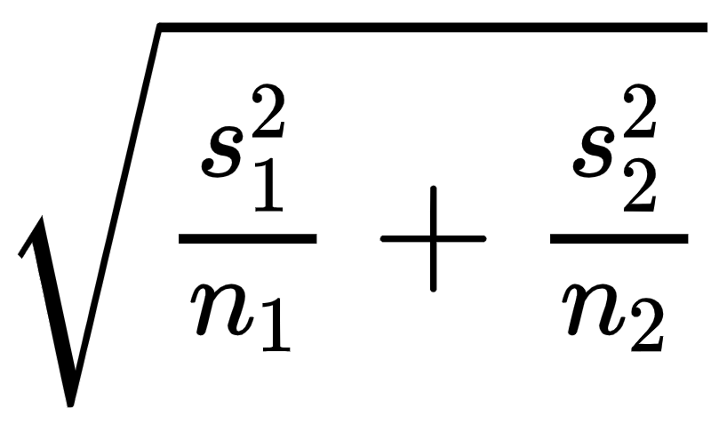
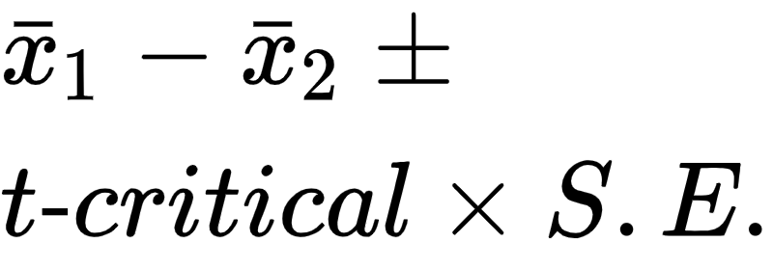
t-statistics, One Sample and Two-Samples
standard deviation(s), σ, are not known
n < 30
Statistic | t-statistic (t-value) | S.E. | Confidence Interval | Hypothesis Question | Hypothesis One or Two - sided
Sample Mean (qualitative data) |  |  |  | Sample mean is = μ or different (> or <) than the expected mean, μ= X | H₀: xbar = μ or, x_bar ≤ μ or x_bar ≥ μ
Two- Sample Means (quantitative data) |  |  |  | The difference of two samples means (e.g., avg blood cell counts for two different populations, w and w/o cancer) μ₁ - μ₂ differ by a hypothesized amount (μ₁ - μ₂ = Δx) or are less than or equal to a hypothesized amount Δx. | H₀: μ₁ - μ₂ = Δx or, μ₁ - μ₂ ≤ Δx or μ₁ - μ₂ ≥ Δx
https://www.sgapeio.es/INFORMEST/VICongreso/taller/applets/Sisa/t-thlp.htm
Note: The t-test is basically not “valid” for testing the difference between two proportions - because it is derived for population means. However, the t-test in proportions has been extensively studied, has been found to be robust, and is widely and successfully used in proportional data. With one exception: if one of the proportions is very close to zero, one or minus one, you will do better with Fisher's exact test.
That said, if you can get large enough sample, typically use a z-test for testing rates (i.e., proportions) with a very good estimate of the std dev, and lots of samples.

Slide 26
Hypothesis Testing Procedure
Step 1: state hypothesis H₀ as alternative to the assertion, H_{A} is the alternative,
(“assertion”) or the claim
H₀ : (Null Hypothesis) … expected result
H_{A} : Alternative Hypothesis … the assertion or claim
The null hypothesis always states that the sample mean is equal to the expected or advertised mean. The assertion or alternative hypothesis always states that the sample mean is different than the expected mean.
Step 2: Verify the conditions of inference
Step 3: Calculate the test statistic (t-statistic or z-statistic) and the p-value
(probability in the tail(s))
Step 4: state your decision … If p ≥ α, fail to reject null, if p < α reject the null hypothesis
Because p < α, we reject the null hypothesis. There is sufficient evidence to conclude that the measurement is biased.
Because p > α, we fail to reject the null hypothesis. There is not sufficient evidence to conclude that the measurement is biased.
Assumptions for Inference
Randomness | Data is collected randomly
Samples are Independent | Population ≥ 10n 1. Population is at least 10 times the sample size or 2. sampling with replacement
Normality | N ≥ 30 or the parent distribution must be normal - e.g., population parameter is normally distributed: the weight of gold bars normally distributed. This assumption should validated be if using a t-distribution.
Sample
Transform to t or z statistic
Look up tail probability p
sample
mean
Population
YouTube Video Examples
https://www.sophia.org/tutorials/z-test-for-population-means-7
https://www.sophia.org/tutorials/t-tests-4

Slide 27
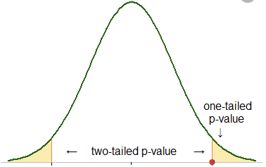
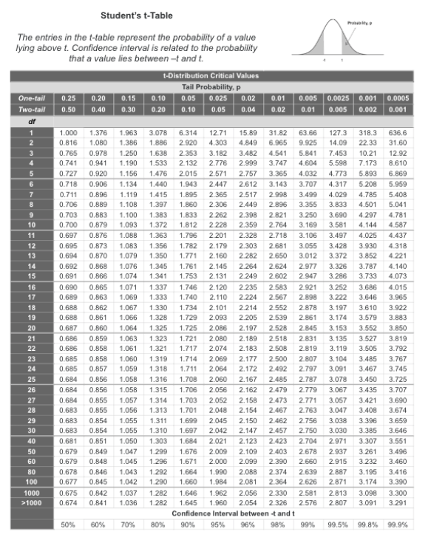
T-table
1-α
e.g. 95%
One-sided (“one-tail)
t-value is (point on the line) corresponding to the p-value (probability under the tail, e.g., α = .05, 5%) at the t-value = 1.695, at df = 30
Two-sided (“two-tail)
t-value is (point on the line) corresponding to the p-value (probability under both tail, e.g., α = .1, 10%) at the t-value = 1.695, at df = 30
Two side alpha, significance, corresponds to ½ of one-sided alpha
α₂ = α₁/ 2
*If the t-table (or function) is a one-sided table then easily convert.
α is the total percentage in the tails. For two-sided problems it is split into the two tails. For one sided problems it is all in one tail.

Slide 28

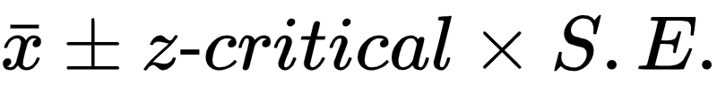
Example, confidence interval: z-statistic (Normal Distribution) for mean or proportions (std deviation known)
You take 14 longitude samples from your measurement instrument
What is the 95% confidence interval of the population mean, μ,
based on these measurements
Confidence Interval =
sample mean = 48.07
z-value = Norminv(0.95,0,1) = 1.6448 (Norminv Excel function)
q = 1 - p
S.E =sqrt(pq/n) = sqrt(.095 •.05 / 14) = 0.058248
μ = 48.07 +/- 1.6448 • 0.058248 = 48.07 +/ 0.0958
95% confidence interval = (47.974 , 48.16558 )
-z-critical
Z-critical
z-value is a point on the Normal distribution x-axis

Slide 29
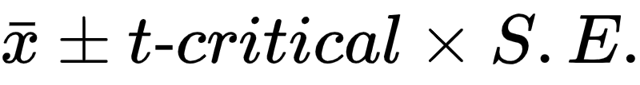
Example, confidence Intervals with t-statistic
(std deviation not known)
t-statistic for population means
You take 14 longitude samples from your measurement instrument
s = sample mean
What is the 95% confidence interval of the population mean
Confidence Interval for =
sample mean = 48.07
t-value = T.inv(0.95,13) = 1.771 (T.inv Excel function)
S.E. = s / sqrt(n)
s = sample std dev = 0.6
S.E = 0.6 / sqrt(14) = 0.160
Confidence interval = 48.07 +/- 1.771 • 0.160 = 48.07 +/- 0.2883
95% confidence = (47.7864 , 48.35386 )
t-value (t-statistic) is a point on the t-distribution x-axis

Slide 30
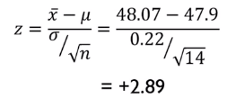
Example: Z-test hypothesis: Are the longitude measurements biased?
You suspect that your longitude measurement are biased. A person is standing at 47.9 longitude. You receive a 14 sample longitude measurements from a test device. The population is very large (e.g., you can make measurements at infinitem) and we know that our underlying longitude samples are normally distributed about the population mean (underlying distribution is normal). You want to be 95% confident in your conclusion (α = .05, significance). You know the standard deviation of the population (not usual), σ = 0.22
Step 1: state hypothesis H₀ as alternative to the assertion, H₁ is the clam (“assertion”)
H₀ : (Null Hypothesis), μ = 47.9.
H₁ : μ ≠ 47.9 … the assertion is that the population mean is closer to the sample mean than the around the supposed population mean of 47.9
two-sided test because the H₀ stated as “μ =” so both tails correspond to H₁
If H₀ stated as “μ ≤” or “≥” then one sided right or left, respectively
Step 2: Verify the conditions of inference
Step 3: Calculate the t-value (test statistic) and p-value probability in the tail(s)
Calculate the sample mean to be 48.07, calculate z-statistic, calculate probability of both tails = .0038. Thus the p-value is small (p < α), much smaller than the desired 95% confidence (α = .05), so it is very unlikely that z-statistic (z-value) falls in the tail.
Step 4: state your decision … If p ≥ α, fail to reject null, otherwise reject
Because p-value < α. Accept reject the null hypothesis. There is sufficient evidence to conclude that the measurement is biased.
p-value (tail probability)
-t-critical
z-critical
Samples
z-statistic (z-value) for population means
2(P(z> 2.89)) = 2(0.019) = 0.0038
P(z > 2.89) = 1-NORM.S.DIST(2.89,TRUE)

Slide 31


Example t-test: are the longitude measurements biased?
You suspect that your longitude measurement instrument is biased. A person is standing at 47.9 longitude. You receive a 14 sample longitude measurements from a test device. The population is very large (e.g., you can make measurements at infinitem) and we know that our underlying longitude samples are normally distributed about the population mean (underlying distribution is normal). You want to be 95% confident in your conclusion (α = .05, significance level). Note, in this case we do not know the population standard deviation (the usual case)
Step 1: state hypothesis
H₀ : (Null Hypothesis), μ = 47.9. State the Null as the alternative to the assertion.
The null always includes equality.
H₁ : μ ≠ 47.9 the assertion is that the population mean is closer to the sample mean than the around the supposed population mean of 47.9
two-sided test because the H₀ stated as equality μ “=”
If stated as μ ≤ or ≥ then one sided, right or left sided, respectively
Step 2: Verify the conditions (assumptions) of inference
Step 3: Calculate the t-value (test statistic) and p-value (two-sided test)
Reading from the table 1.06 corresponds to p-value between 0.3 to 0.4 > 0.05
Or using the excel function for two-sided p-value = 2*(1-T.DIST(1.06,13,TRUE) = 0.31
The p-value (tail probability) is large (p > α). The t statistic 95% variability could fall within the tail region.Thus, cannot conclude with 95% confidence.
Step 4: state your decision If p ≥ α, fail to reject null, otherwise reject
Because p-value > α, fail to reject the null hypothesis. There is not sufficient evidence to conclude that the measurement is biased.
-t-critical
t-critical
14 Samples
t-statistic (“t-value”, “critical value”) for population means

Slide 32
Lab Exercise/Demo
Exploratory Data Analysis

Slide 33
z-test references
t-test references
https://www.cliffsnotes.com/study-guides/statistics/univariate-inferential-tests/one-sample-z-test
https://www.cliffsnotes.com/study-guides/statistics/univariate-inferential-tests/test-for-a-single-population-proportion
https://www.cliffsnotes.com/study-guides/statistics/univariate-inferential-tests/two-sample-z-test-for-comparing-two-means
https://www.cliffsnotes.com/study-guides/statistics/univariate-inferential-tests/test-for-comparing-two-proportions
https://www.cliffsnotes.com/study-guides/statistics/univariate-inferential-tests/one-sample-t-test
https://www.cliffsnotes.com/study-guides/statistics/univariate-inferential-tests/two-sample-t-test-for-comparing-two-means

Slide 34
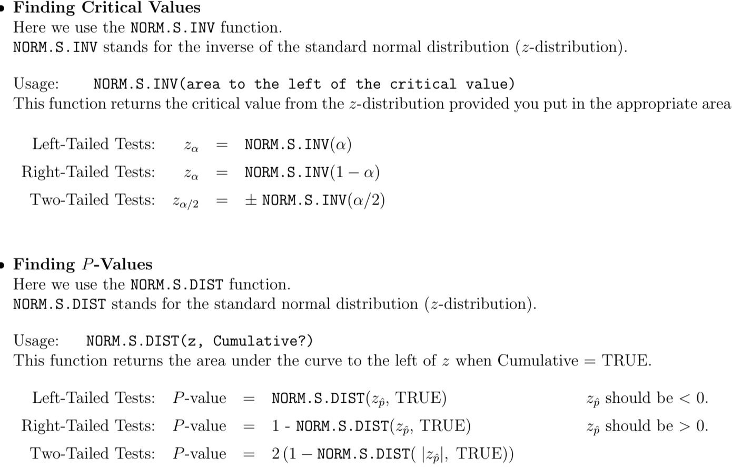
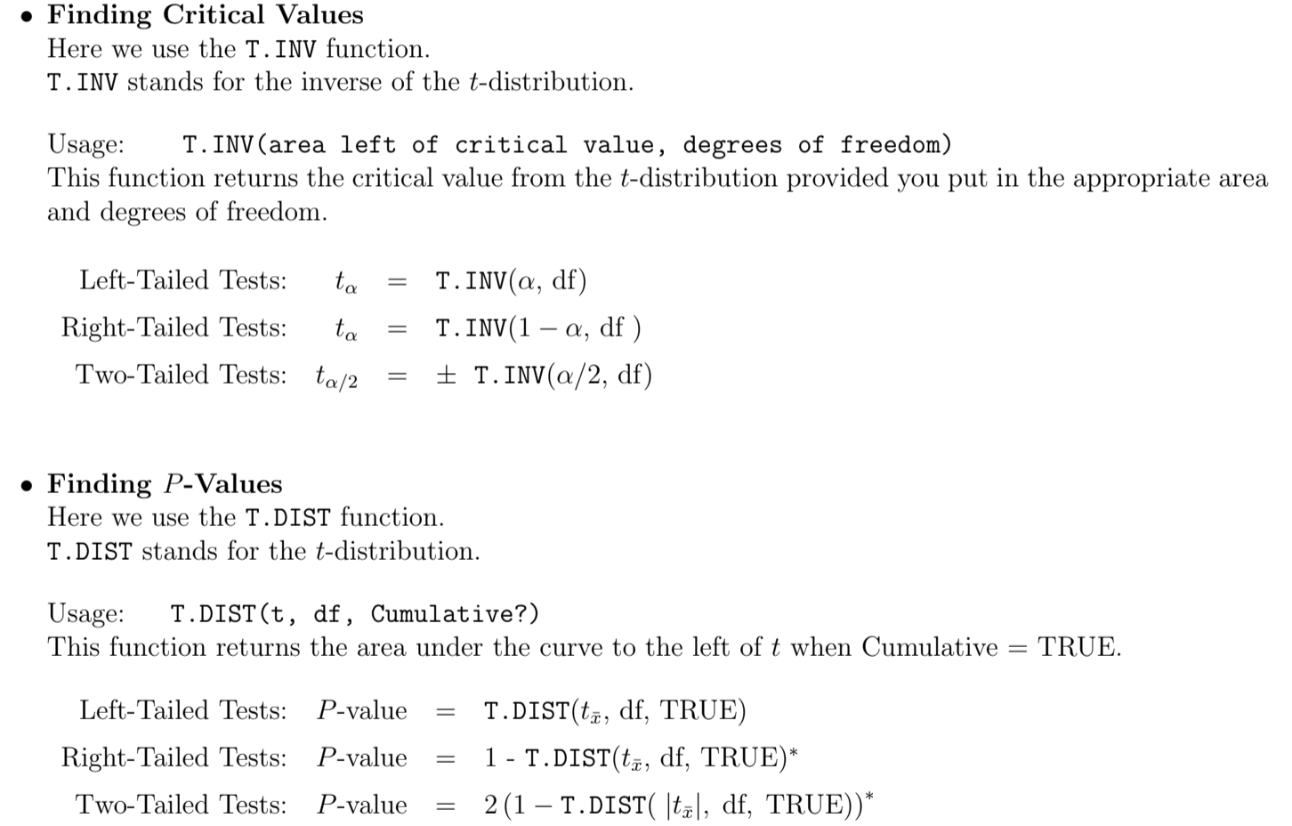
Excel t-test and z-test conversions
https://cosmosweb.champlain.edu/people/stevens/webtech/excelfiles/chap8-excel.pdf

Slide 35
Lab Exercise/Demos
Exploratory Data Analysis
Inference Statistics
Regression

Slide 36
Session 4: Visualizations
Guided practice using common statistics
Q&A
Op requested statistics topics
Statistics usage tips and tricks - Google SQL

Slide 37
Lab Exercise/Demos
Visualizations

